Slide 1

Progress Report on
Pelvic Bone Fracture with Injury Segmentation
Shirshak Acharya,
Research Assistant, NAAMII

Slide 2
Outline
Hip Bone CT Scan Dataset
Training Pipeline
Anatomical Model
Fracture Segmentation Model
Inference Pipeline
Anatomical Model
Fracture Segmentation Model
Results
Anatomical Model
Fracture Segmentation Model

Slide 3
Outline
Hip Bone CT Scan Dataset
Training Pipeline
Anatomical Model
Fracture Segmentation Model
Inference Pipeline
Anatomical Model
Fracture Segmentation Model
Results
Anatomical Model
Fracture Segmentation Model

Slide 4
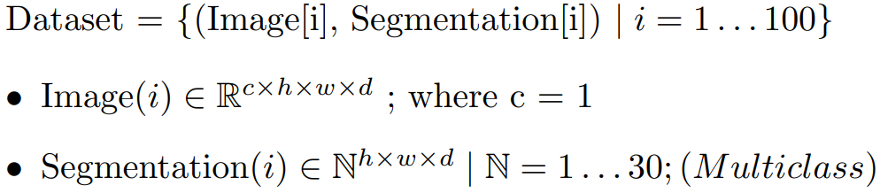
Hip Bone CT Scan Dataset
Task

Slide 5
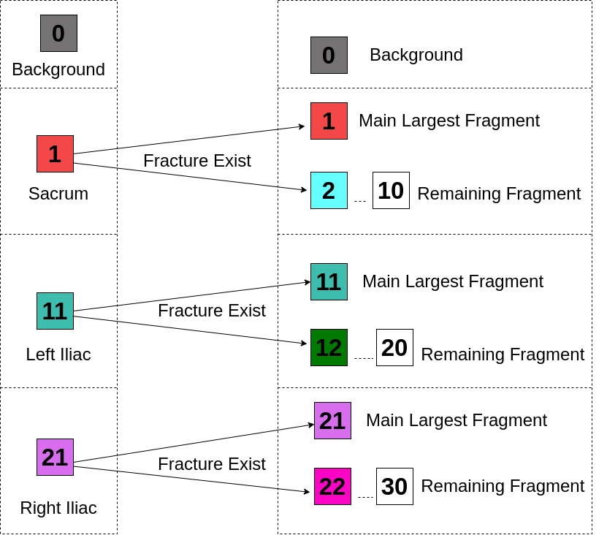
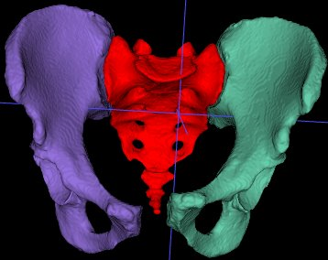
Label For Hip with No Fractures

Slide 6
Labels of 3 hip structures with & without fracture

Slide 7
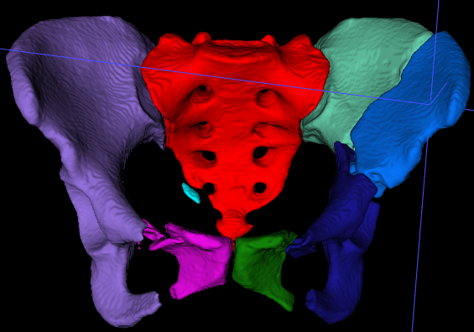
Labels of 3 hip structures with & without fracture
B
0
S
1
2
L
11
12
13
14
R
21
22
B : Background
S : Sacrum
L : Left Iliac
R : Right Iliac

Slide 8
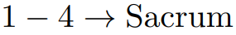
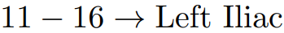
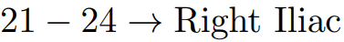
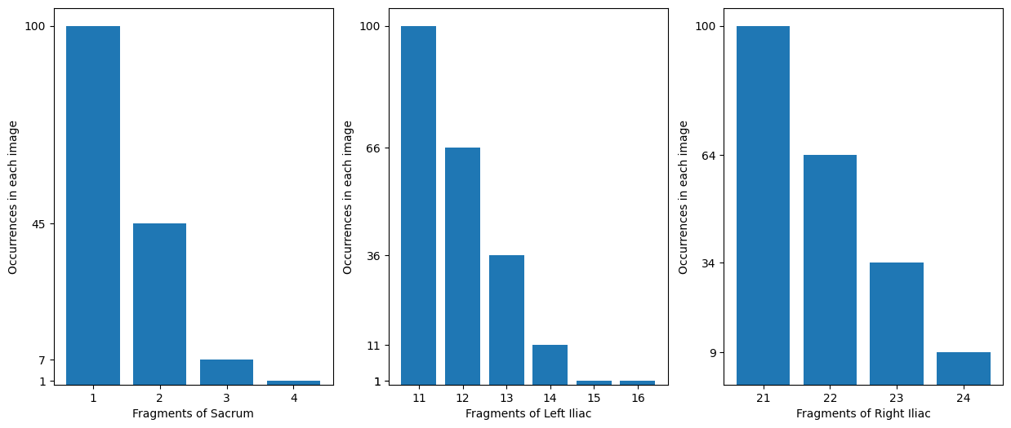
Frequency of Labels
Fig 11.1 : Unique Labels with their number of occurrences.

Slide 9
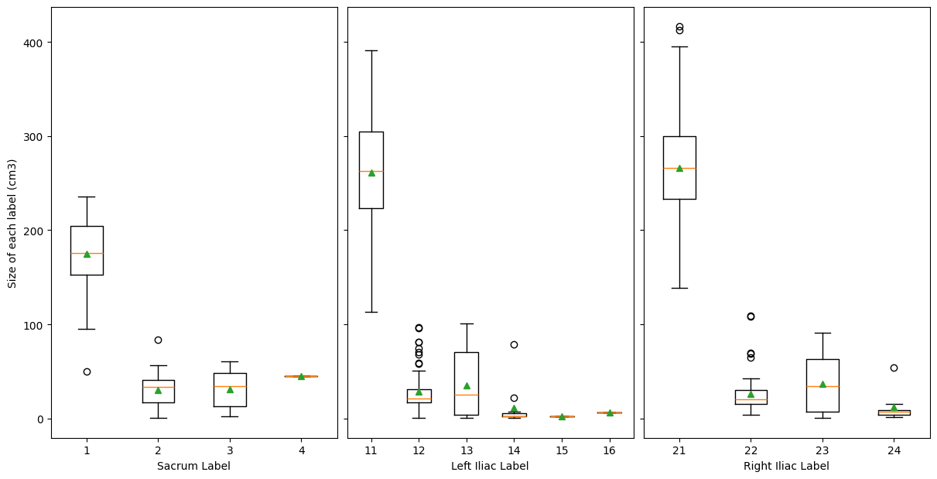
Box Plot of 3 hip structure's label vs their size

Slide 10
Limited Data
Only consists of 100 CT Scans given
Around 348 CT Scan taken from CTPELVIC1K data
More Data = Better Performance !!

Slide 11
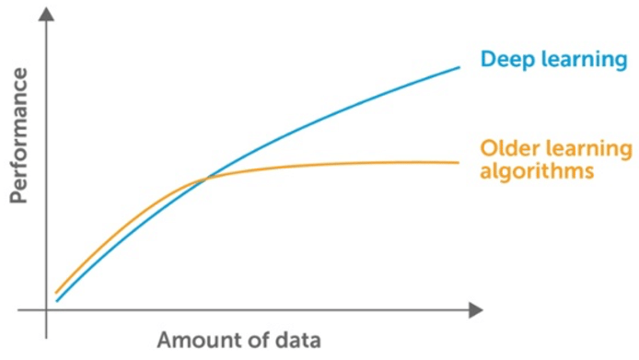
Limited Data
Only consists of 100 CT Scans given
Around 348 CT Scan taken from CTPELVIC1K data
More Data = Better Performance !!

Slide 12
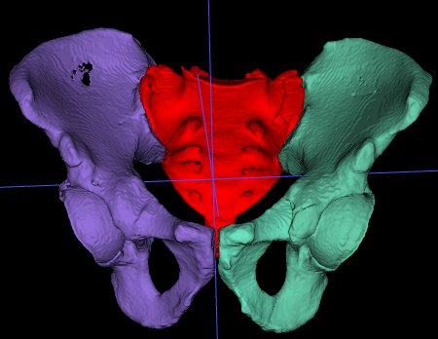
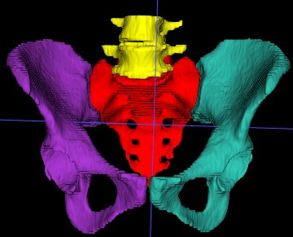
Limited Data
Only consists of 100 CT Scans given
Around 348 CT Scan taken from CTPELVIC1K data
More Data = Better Performance !!
Example CT Scan Label : 100 CT FracSeg data
Example CT Scan Label : CTPELVIC1K dataset

Slide 13
Outline
Hip Bone CT Scan Dataset
Training Pipeline
Anatomical Model
Fracture Segmentation Model
Inference Pipeline
Anatomical Model
Fracture Segmentation Model
Results
Anatomical Model
Fracture Segmentation Model

Slide 14
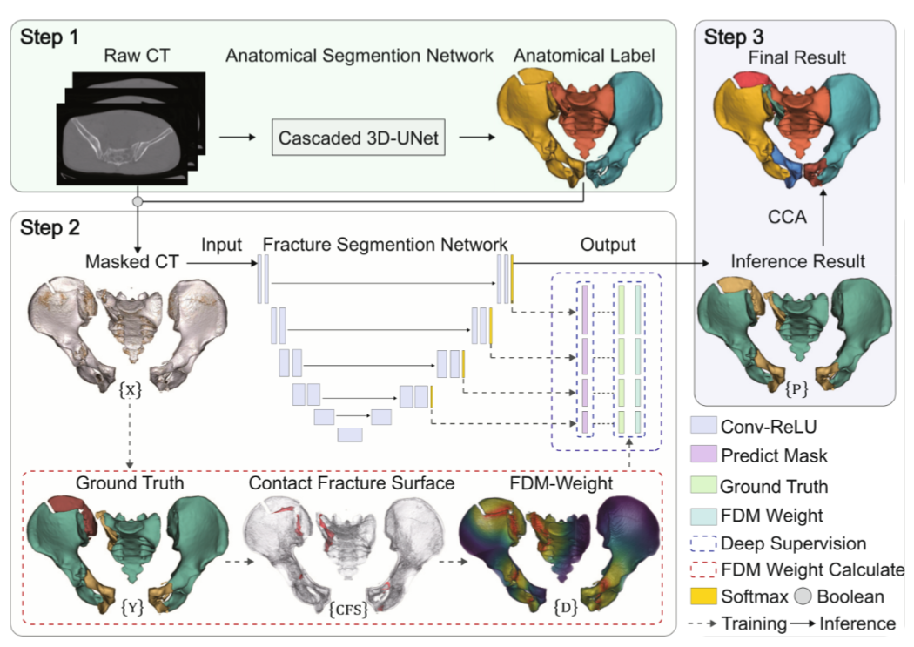
Author proposed Fracture Segmentation Model
Liu Y, Yibulayimu S, Sang Y, Zhu G, Wang Y, Zhao C, Wu X. Pelvic fracture segmentation using a multi-scale distance-weighted neural network. In International Conference on Medical Image Computing and Computer-Assisted Intervention 2023 Oct 1 (pp. 312-321). Cham: Springer Nature Switzerland.

Slide 15
Outline
Hip Bone CT Scan Dataset
Training Pipeline
Anatomical Model
Fracture Segmentation Model
Inference Pipeline
Anatomical Model
Fracture Segmentation Model
Results
Anatomical Model
Fracture Segmentation Model

Slide 16
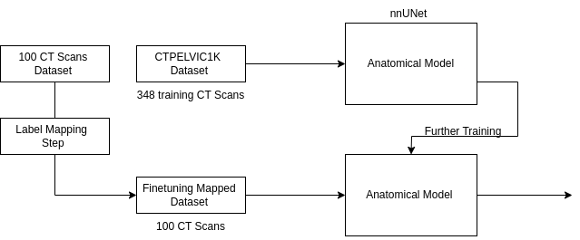

Training Pipeline Anatomical Segmentation

Slide 17
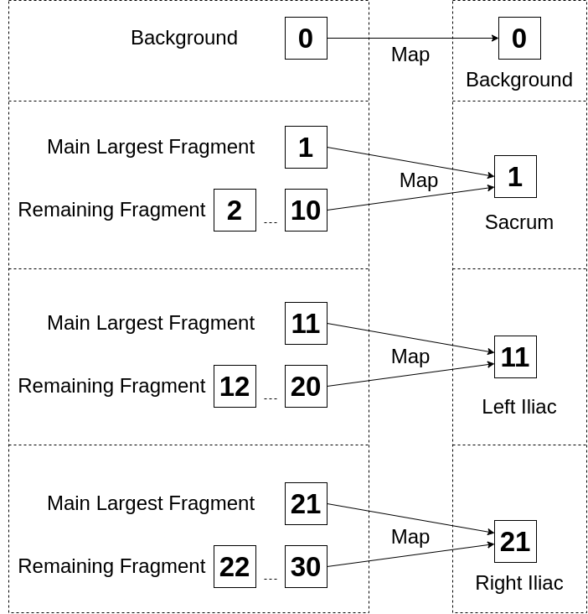
Label Mapping Step

Slide 18
Outline
Hip Bone CT Scan Dataset
Training Pipeline
Anatomical Model
Fracture Segmentation Model
Inference Pipeline
Anatomical Model
Fracture Segmentation Model
Results
Anatomical Model
Fracture Segmentation Model

Slide 19
Fracture Segmentation Steps
Fracture Distance Map
Multi Scale Deep Supervision
Smooth Transition

Slide 20
Fracture Segmentation Steps
Fracture Distance Map
Multi Scale Deep Supervision
Smooth Transition
Performance Enhancement
Stabilize Training

Slide 21
Fracture Distance Map
Fracture Segmentation Network aim to :
Segments each hip bone to :
Main Fragment
Remaining Fragment
Give more weight for segmentation of Contact Fracture Surface (CFS)

Slide 22
Fracture Distance Map
Fracture Segmentation Network aim to :
Segments each hip bone to :
Main Fragment
Remaining Fragment
Give more weight for segmentation of Contact Fracture Surface (CFS)
Contact Fracture Surface (CFS)
Part where bone collide due to compression and impact

Slide 23
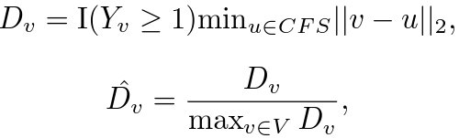
Steps for calculate FDM
Compare label with each voxel neighborhood to identify CFS

Slide 24
Steps for calculate FDM
Compare label with each voxel neighborhood to identify CFS
where, Y is ground-truth segmentation, v = (h,w,d) ∈ V is voxel index, I(Y_{v} ≥ 1) is indicator function for foreground

Slide 25
Steps for calculate FDM
Compare label with each voxel neighborhood to identify CFS
where, Y is ground-truth segmentation, v = (h,w,d) ∈ V is voxel index, I(Y_{v} ≥ 1) is indicator function for foreground
For each foreground voxel, 'v' calculate distance 'D_{v}' to nearest CFS

Slide 26
Steps for calculate FDM
Compare label with each voxel neighborhood to identify CFS
where, Y is ground-truth segmentation, v = (h,w,d) ∈ V is voxel index, I(Y_{v} ≥ 1) is indicator function for foreground
For each foreground voxel, 'v' calculate distance 'D_{v}' to nearest CFS
Where Ď_{v} is the normalized distance.

Slide 27
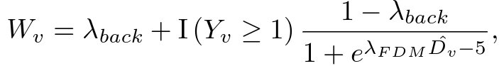
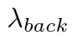
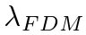
Steps for calculate FDM (cont.)
Calculate FDM weight
∵ = 0.2, = 16

Slide 28
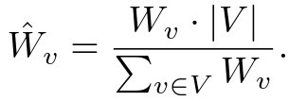
Steps for calculate FDM (cont.)
Calculate FDM weight
Normalize weight to make avg. weight = 1
∵ = 0.2, = 16

Slide 29
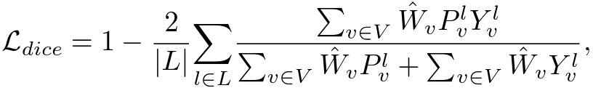
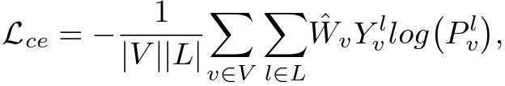
Using FDM weight for weighted Dice and CE Loss
where L = num of labels, P^{l}_{v} , Y^{l}_{v} are output prediction and ground truth for l^{th} label and v^{th} voxel . ​

Slide 30
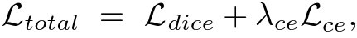
FDM overall loss
The overall loss is weighted sum of dice and cross entropy. ​
where, λ_{ce} = 1 is a balancing weight.

Slide 31
Multi Scale Deep Supervision
Multiscale Attention
Feature of different resolution of decoder upsampled to form SLF(Single Layer Feature)
All SLF combined and then conv. operation is applied to form MLF (Multi Layer Feature)
Each SLF multiplied with MLF to form AFM (Attentive Feature Map) to each decoder block output

Slide 32
Multi Scale Deep Supervision
Multiscale Attention
Feature of different resolution of decoder upsampled to form SLF(Single Layer Feature)
All SLF combined and then conv. operation is applied to form MLF (Multi Layer Feature)
Each SLF multiplied with MLF to form AFM (Attentive Feature Map) to each decoder block output

Slide 33
Multi Scale Deep Supervision
Multiscale Attention
Feature of different resolution of decoder upsampled to form SLF(Single Layer Feature)
All SLF combined and then conv. operation is applied to form MLF (Multi Layer Feature)
Each SLF multiplied with MLF to form AFM (Attentive Feature Map) to each decoder block output

Slide 34
Multi Scale Deep Supervision
Deep Supervision
Reduces gradient exploding and vanishing problem
Generate multiple predictions from multiple layers
Use Deconvolution to upscale low and mid-level features and use softmax on these upscaled feature to obtain dense predictions
Average all dense predictions to produce accurate segmentation

Slide 35
Multi Scale Deep Supervision
Deep Supervision
Reduces gradient exploding and vanishing problem
Generate multiple predictions from multiple layers
Use Deconvolution to upscale low and mid-level features and use softmax on these upscaled feature to obtain dense predictions
Average all dense predictions to produce accurate segmentation

Slide 36
Multi Scale Deep Supervision
Deep Supervision
Reduces gradient exploding and vanishing problem
Generate multiple predictions from multiple layers
Use Deconvolution to upscale low and mid-level features and use softmax on these upscaled feature to obtain dense predictions
Average all dense predictions to produce accurate segmentation

Slide 37
Multi Scale Deep Supervision
Deep Supervision
Reduces gradient exploding and vanishing problem
Generate multiple predictions from multiple layers
Use Deconvolution to upscale low and mid-level features and use softmax on these upscaled feature to obtain dense predictions
Average all dense predictions to produce accurate segmentation

Slide 38
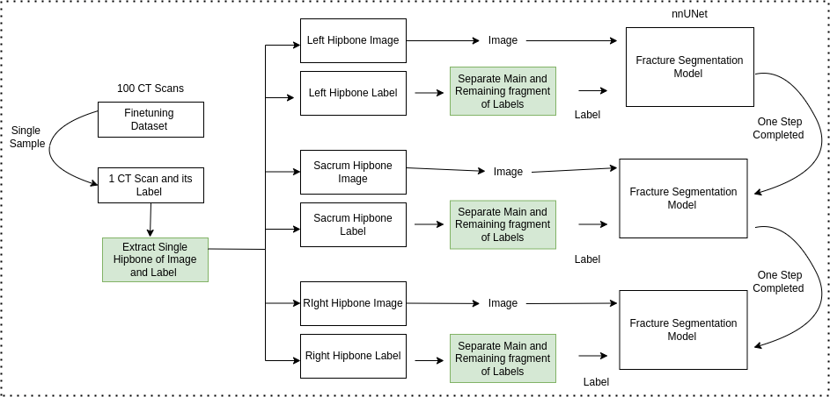
Training Pipeline Fracture Segmentation

Slide 39
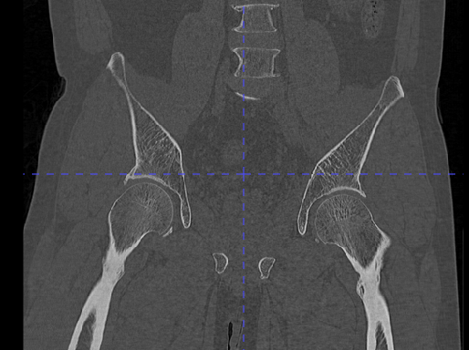
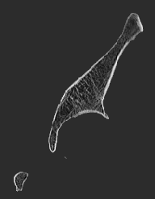
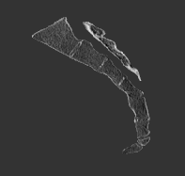
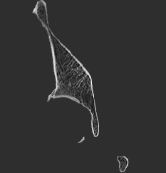
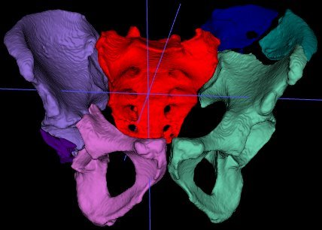
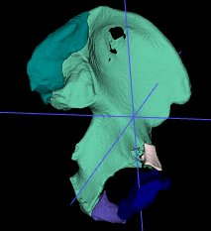
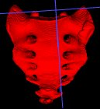
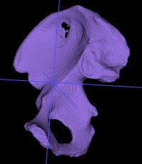
Extract single hipbone part of Image and Label
CT_IMG_LI_001.nii.gz
CT_IMG_LI_001.nii.gz
CT_IMG_LI_001.nii.gz
CT_IMG_LI_001.nii.gz
CT_IMG_001.nii.gz
CT_IMG_LI_001.nii.gz
CT_IMG_SA_001.nii.gz​
CT_IMG_RI_001.nii.gz​
CT_LI_001.nii.gz​
CT_SA_001.nii.gz​​
CT_RI_001.nii.gz​​
CT_IMG_001.nii.gz​

Slide 40
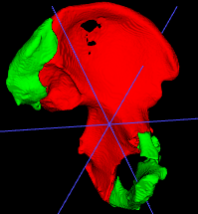
Separate main and remaining fragments of labels
Map multiple Label into main and remaining fragments.
B
0
L
11
12
13
14
B
0
M | R
1 | 2
B : Background
M : Main Fragment
R : Remaining Fragment
B : Background
L : Left Iliac

Slide 41
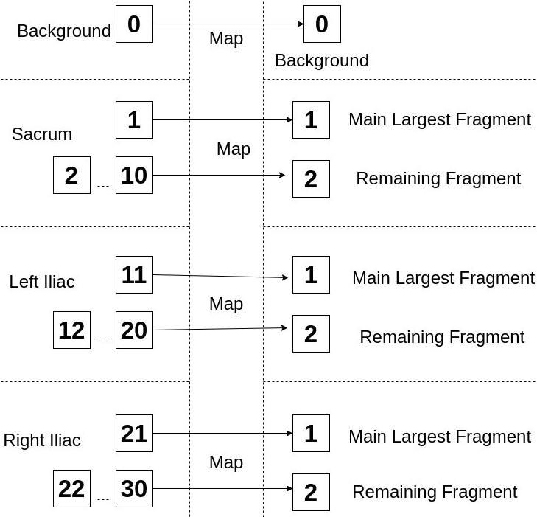
Map Multiple Label in main & remaining fragment

Slide 42
Outline
Hip Bone CT Scan Dataset
Training Pipeline
Anatomical Model
Fracture Segmentation Model
Inference Pipeline
Anatomical Model
Fracture Segmentation Model
Results

Slide 43
Outline
Hip Bone CT Scan Dataset
Training Pipeline
Anatomical Model
Fracture Segmentation Model
Inference Pipeline
Anatomical Model
Fracture Segmentation Model
Results
Anatomical Model
Fracture Segmentation Model

Slide 44
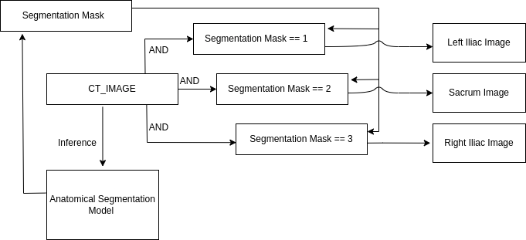
Inference Pipeline Anatomical Segmentation

Slide 45
Outline
Hip Bone CT Scan Dataset
Training Pipeline
Anatomical Model
Fracture Segmentation Model
Inference Pipeline
Anatomical Model
Fracture Segmentation Model
Results
Anatomical Model
Fracture Segmentation Model

Slide 46
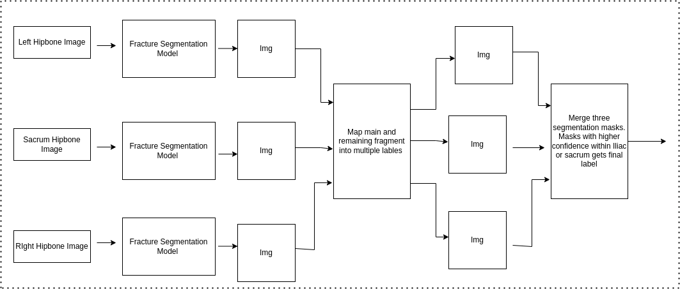

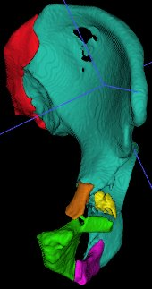
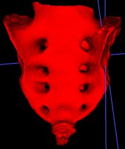
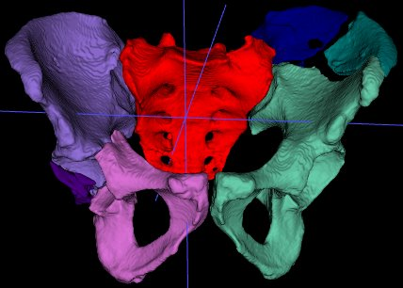
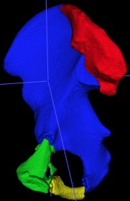
Inference Pipeline Fracture Segmentation

Slide 47
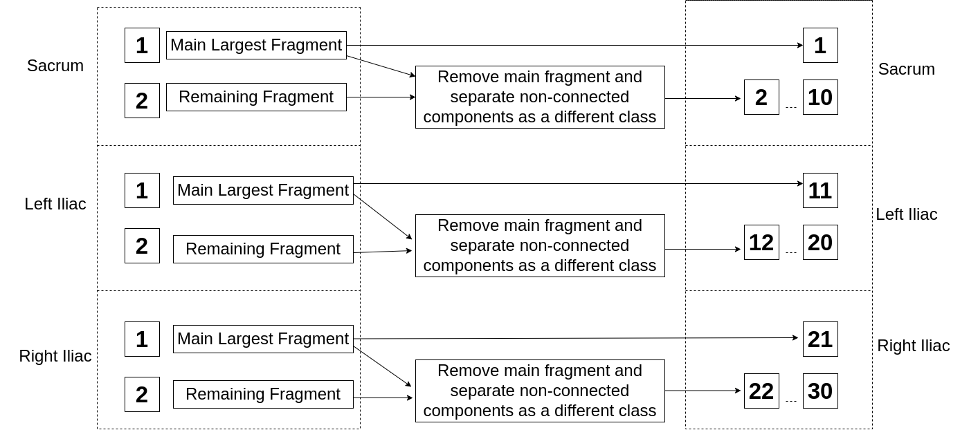
Map main & fragments in multiple labels

Slide 48
Outline
Hip Bone CT Scan Dataset
Training Pipeline
Anatomical Model
Fracture Segmentation Model
Inference Pipeline
Anatomical Model
Fracture Segmentation Model
Results
Anatomical Model
Fracture Segmentation Model

Slide 49
Evaluation Metrics
Hausdorff Distance at 95 percentile (hd95)
Dice Loss

Slide 50
Outline
Hip Bone CT Scan Dataset
Training Pipeline
Anatomical Model
Fracture Segmentation Model
Inference Pipeline
Anatomical Model
Fracture Segmentation Model
Results
Anatomical Model
Fracture Segmentation Model

Slide 51
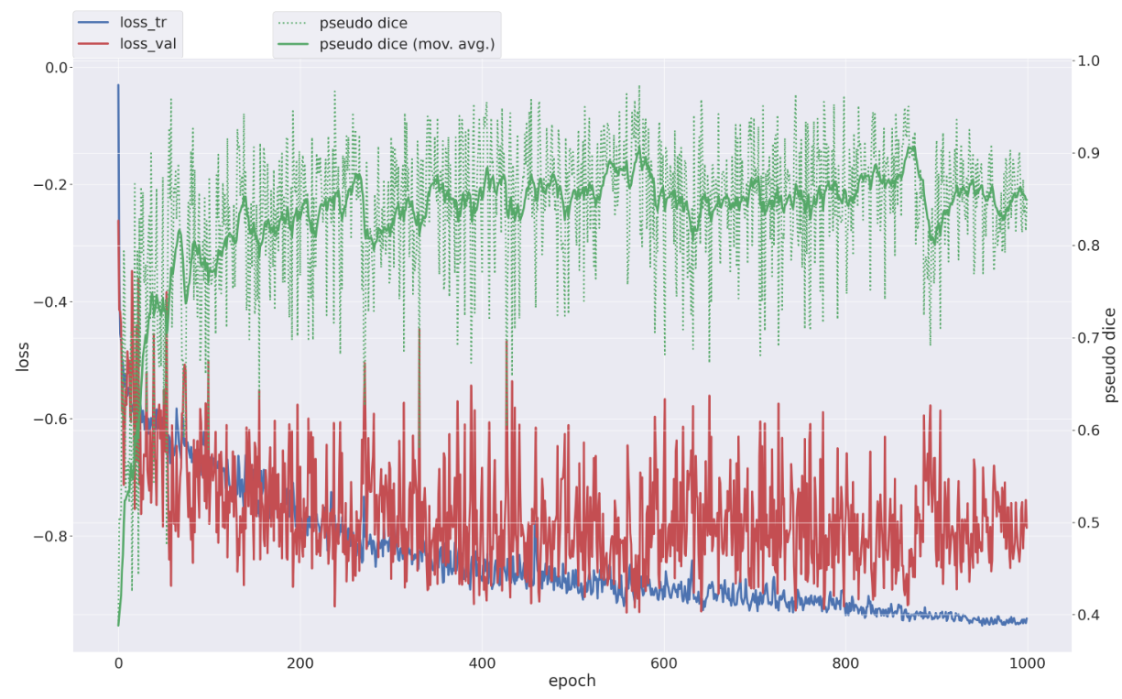
Anatomical Segmentation Result

Slide 52
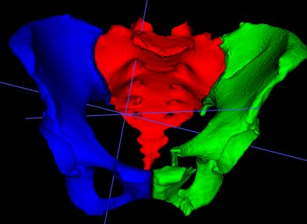
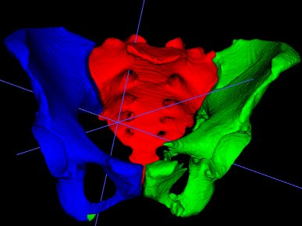
Anatomical Segmentation Result
Segmentation of
012 Image
Prediction of
012 Image
Test Dice Score : 0.9786

Slide 53
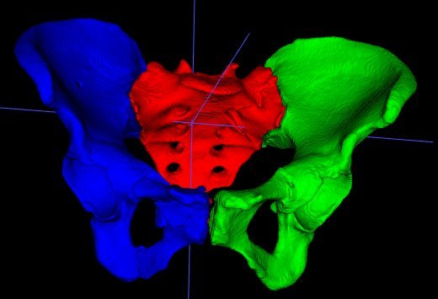
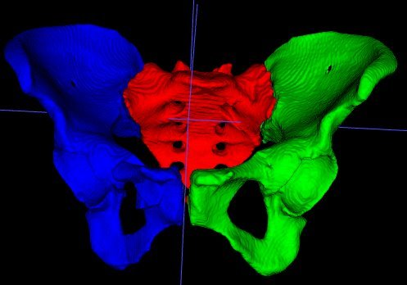
Anatomical Segmentation Result
Segmentation of
012 Image
Prediction of
012 Image
Test Dice Score : 0.9786
Segmentation of
083 Image
Prediction of
083 Image
Test Dice Score : 0.9723

Slide 54
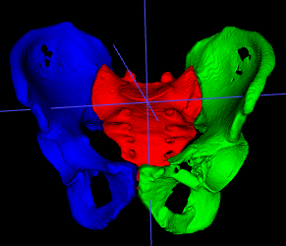
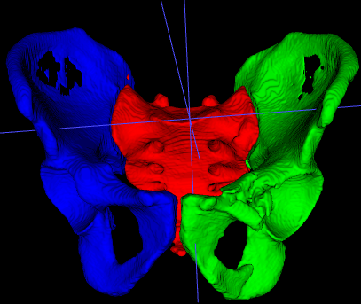
Anatomical Segmentation Result
Segmentation of
012 Image
Prediction of
012 Image
Segmentation of
049 Image
Prediction of
049 Image
Test Dice Score : 0.9786
Test Dice Score : 0.9739
Segmentation of
083 Image
Prediction of
083 Image
Test Dice Score : 0.9723

Slide 55
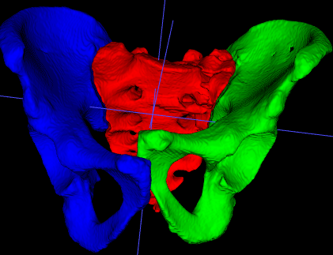
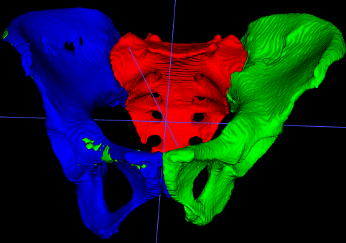
Anatomical Segmentation Result
Segmentation of
012 Image
Prediction of
012 Image
Segmentation of
049 Image
Prediction of
049 Image
Test Dice Score : 0.9786
Test Dice Score : 0.9739
Segmentation of
083 Image
Prediction of
083 Image
Segmentation of
095 Image
Prediction of
095 Image
Test Dice Score : 0.9723
Test Dice Score : 0.9703

Slide 56

Anatomical Segmentation Result
Segmentation of
012 Image
Prediction of
012 Image
Segmentation of
049 Image
Prediction of
049 Image
Overall Dice Score | 0.9738
Test Dice Score : 0.9786
Train Dice Score : 0.9739
Segmentation of
083 Image
Prediction of
083 Image
Segmentation of
095 Image
Prediction of
095 Image
Test Dice Score : 0.9723
Test Dice Score : 0.9703

Slide 57
Outline
Hip Bone CT Scan Dataset
Training Pipeline
Anatomical Model
Fracture Segmentation Model
Inference Pipeline
Anatomical Model
Fracture Segmentation Model
Results
Anatomical Model
Fracture Segmentation Model

Slide 58

Fracture Segmentation Results

Slide 59


Fracture Segmentation Result
Segmentation of
084 LI Image
Prediction of
084 LI Image
Test Dice Score : 99.79 (M), 95.03 (R)
Test Hausdorff : 0 (M), 2.24(R)

Slide 60


Fracture Segmentation Result
Segmentation of
084 LI Image
Prediction of
084 LI Image
Test Dice Score : 99.79 (M), 95.03 (R)
Test Hausdorff : 0 (M), 2.24(R)
Segmentation of
087 LI Image
Prediction of
087 LI Image
Test Dice Score : 85.00 (M), 18.06 (R)
Test Hausdorff : 53.01 (M), 48.92(R)

Slide 61


Fracture Segmentation Result
Segmentation of
084 LI Image
Prediction of
084 LI Image
Segmentation of
085 SA Image
Prediction of
085 SA Image
Test Dice Score : 99.79 (M), 95.03 (R)
Test Dice Score : 99.75 (M), 98.92 (R)
Test Hausdorff : 0 (M), 2.24(R)
Test Hausdorff : 0 (M), 0 (R)
Segmentation of
087 LI Image
Prediction of
087 LI Image
Test Dice Score : 85.00 (M), 18.06 (R)
Test Hausdorff : 53.01 (M), 48.92(R)

Slide 62


Fracture Segmentation Result
Segmentation of
084 LI Image
Prediction of
084 LI Image
Segmentation of
085 SA Image
Prediction of
085 SA Image
Test Dice Score : 99.79 (M), 95.03 (R)
Test Dice Score : 99.75 (M), 98.92 (R)
Test Hausdorff : 0 (M), 2.24(R)
Test Hausdorff : 0 (M), 0 (R)
Segmentation of
087 LI Image
Prediction of
087 LI Image
Segmentation of
095 LI Image
Prediction of
095 LI Image
Test Dice Score : 85.00 (M), 18.06 (R)
Test Dice Score : 96.35 (M), 92.53 (R)
Test Hausdorff : 53.01 (M), 48.92(R)
Test Hausdorff : 10.49(M), 18.82 (R)

Slide 63
Fracture Segmentation Results
Model | Metric | I-main | I-other | S-main | S-other | All
FDMSS UNet (author) | DSC | 99.78 | 99.05 | 99.57 | 97.87 | 99.38
 | HD95 | 13.24 | 19.43 | 14.85 | 19.89 | 17.12
FDMSS UNet (ours) | DSC | 98.64 | 93.13 | 97.33 | 88.72 | 94.93
 | HD95 | 4.51 | 11.29 | 3.95 | 11.83 | 7.89
Sum/4
Sum/4
FDMSS : Fracture Distance Map (FDM) Weighted Loss with Deep Supervision and Deep Transition

Slide 64


Fracture Segmentation example Results
Segmentation of 081 Image
Prediction of 081 Image
Test Dice Score : 99.7
Test Hausdorff : 0

Slide 65


Fracture Segmentation example Results
Segmentation of 086 Image
Prediction of 086 Image
Test Dice Score : 92.8
Test Hausdorff : 19.03

Slide 66


Fracture Segmentation example Results
Segmentation of 092 Image
Prediction of 086 Image
Test Dice Score : 99.7
Test Hausdorff : 0

Slide 67


Fracture Segmentation example Results
Segmentation of 097 Image
Prediction of 097 Image
Test Dice Score : 99.7
Test Hausdorff : 0

